Slide 1

University-Wide Predictors of Academic Performance at Cape Peninsula University of Technology
Chumani Platyi, 219203261, Academic supervisor: Dr T. Farrar, Fundani Institutional Planning CPUT, Mentors: M. Nakhooda, X. Cupido, L. Mapatagane

Slide 2
Contents

Slide 3
Introduction
Methodology
Results & Discussion
Conclusion
References

Slide 4
Introduction

Slide 5
Background
Performance Dashboards are a key component of a performance management system.
Identifying and monitoring key performance metrics is crucial for the university administration.
The basic function of performance metrics is to assist in determining how well a particular university
or department/faculty has achieved its respective goals.

Slide 6
Business Problem
The Cape Peninsula University of Technology (CPUT) is facing challenges in optimizing academic performance across its entire university system.
To enhance student success and educational outcomes, there is a need to identify
and understand the key predictors of academic performance that are applicable university-wide.
By gaining insights into these predictors, the university aims to implement targeted interventions
and strategies to improve overall student achievement.

Slide 7
Objectives
What is the relationship between a student’s residence status (in res; not in res) and the outcome per subject?
What is the relationship between a student’s registration date and the outcome per subject?
What is the relationship between a student’s residence status (in res; not in res) and the throughput outcome?

Slide 8
Benefits
The identification of predictors of academic performance allows the university to implement targeted interventions,
leading to improved overall student achievement.
This contributes to higher graduation rates and the academic achievement of students.

Slide 9
Methodology

Slide 10
Data Source
This study uses a dataset that consists of academic records, application data.
For all CPUT students studying undergraduate qualification from 2018 to 2022.
This study also uses residence, curriculum and enrollment dataset.
Academic (1746490 obs. of 26 var), residence (48728 obs. Of 11 var),and
Application (1348770 obs. of 40 var)
The dataset includes for each student the enrollment date for the diploma or degree, every single course they enrolled in.

Slide 11
Variable Name | Types | Units Measurement
IDEN | Integer | Student Identification number.
ENGLISH | Integer | NSC English results.
ENGLISH_TYPE | Categorical | Home Language or First Additional Language
Life Orientation | Integer | NSC Life Orientation results
PASS_FAIL | Categorical | You pass or fail an exam.
STAYED_IN_RESYes | Categorical | YES or NO
RegDelayWeeks | Integer | Weeks from 1 to 15

Slide 12
Transformation of Data
The academic records and residence data were joined using left join.
Primary keys are IDEN and YEAR.
New variables were created STAYED_IN_RES, RegDelayWeeks, and RegDelayDays.
Was created after joining the academic records data with the residence data.
Also, the academic records and application data were joined using left join.
Primary key is IDEN
The period of study was also filtered to be 4 or less.

Slide 13
Data analysis
In this study R and Microsoft Power BI were used for analysis.
This study uses the following software packages
tidyverse (Chang,Miller, and Muller, 2019)
broom (Couch , Hayes, and Robinson, 2023).
Regression Equations:
Logit(P)= -0.412 +0.0126ENGLISH​+0.369​ENGLISH_TYPEHOME ​+0.0151LIFE ORIENTATION
Logit(P) = 1.77+0.34STAYED_IN_RESYes ​-0.111RegDelayWeeks​

Slide 14
Results & Discussion

Slide 15
Logistic Regression
1.012635. For every additional 1% in NSC English mark, odds of passing a CPUT subject are estimated to increase by 1.26%.
1.01523. For every additional 1% in NSC Life Orientation mark, odds of passing a CPUT subject are estimated to increase by 1.52%.
1.446236. Odds of passing a CPUT subject are 44.6% higher for a student who did English Home Language in NSC, then for a student who did English First Additional Language in NSC.
term estimate std.error statistic p.value
<chr> <dbl> <dbl> <dbl> <dbl>
1 (Intercept) -0.412 0.0266 -15.5 4.11e- 54
2 ENGLISH 0.0126 0.000392 32.1 2.00e-23
3 ENGLISH_TYPEHOME 0.369 0.00711 51.9 0
4 `LIFE ORIENTATION` 0.0151 0.000337 44.8 0

Slide 16
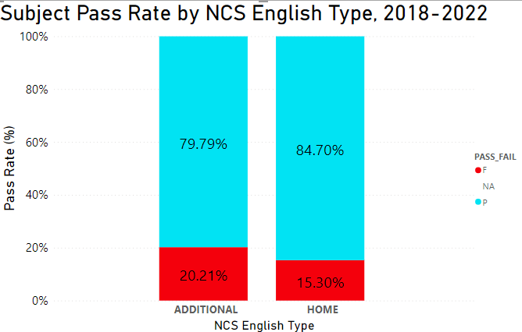

Slide 17
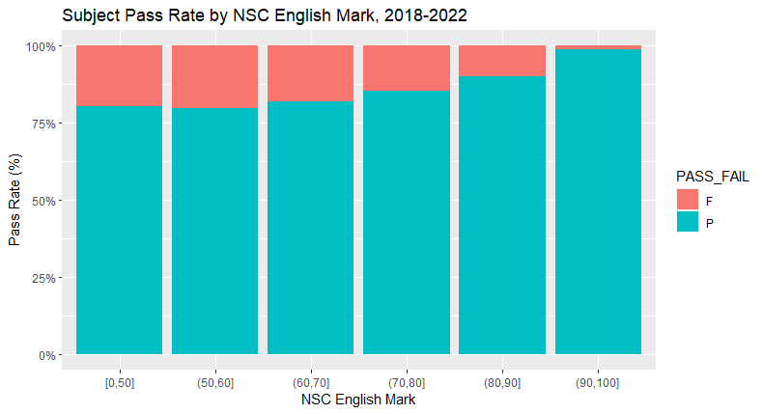

Slide 18
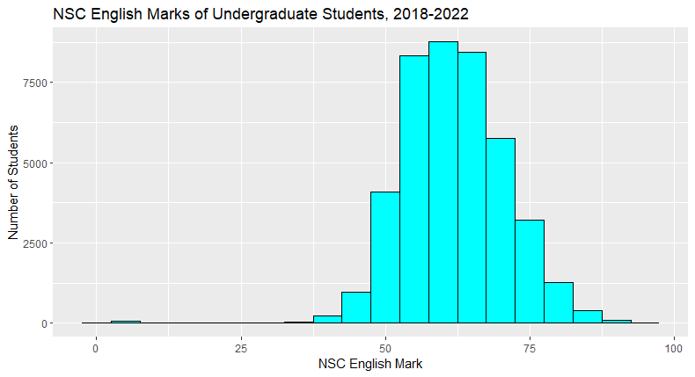
Skewed left: The mean is less than the median.
The distribution have many more data points on one side of a graph than the other.
Students who wrote NSC English many of them pass with 50% and above.

Slide 19
Logistic Regression
1.408232. Odds of passing are 40.8% higher for a student staying in residence, compared to a student not staying in residence.
1.11731 odds of passing decrease by 11.7% for every additional week of delay in registering.
term estimate std.error statistic p.value
<chr> <dbl> <dbl> <dbl> <dbl>
1 (Intercept) 1.77 0.00448 397. 0
2 STAYED_IN_RESYes 0.342 0.00690 49.6 0
3 RegDelayWeeks -0.111 0.000947 -117. 0

Slide 20
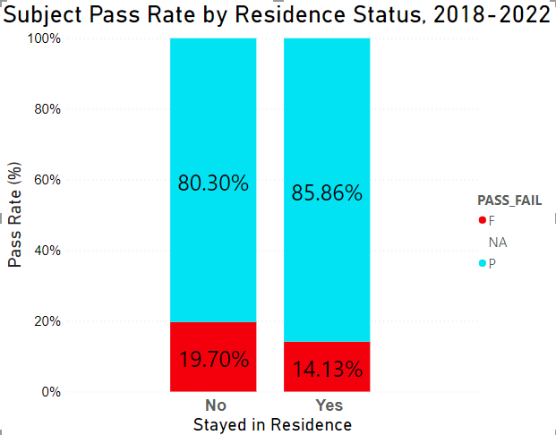

Slide 21
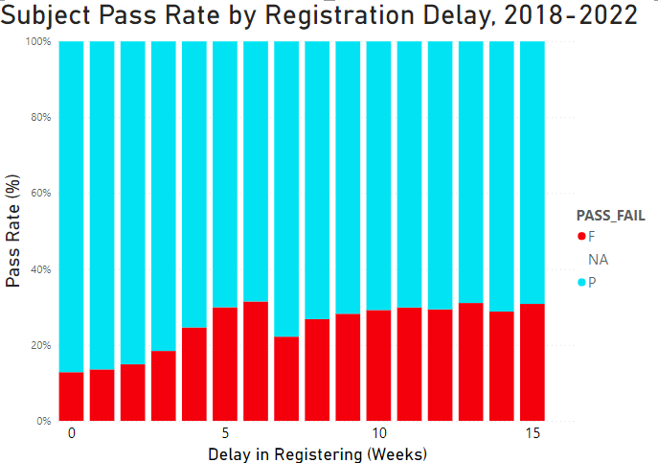

Slide 22
Conclusion & Recommendations
This study finds that students who stayed in residence are likely to pass the subjects compared to those who are not stayed in residence.
Also, this study shows that students who registered earlier in week 1 and 2 are likely to pass the subjects compared to those who registered late in week 4 to 15.
Furthermore, it is found that the delay in registration have negative impact in student’s performance.
Develop and implement specific academic support programs that address the identified predictors of academic performance.
This could include tutoring services, study groups, or workshops tailored to the needs of students in different disciplines.
Engage with Student Organizations.
Monitor and Analyze Registration Data

Slide 23
References
Cape Peninsula University of Technology. Available at: https://www.cput.ac.za/about/history (Accessed: 29 September 2023).
Fundani - Cape Peninsula University of Technology. Available at: https://sda.cput.ac.za/wp-content/uploads/2022/06/FUNDANI-update.pdf (Accessed: 29 September 2023).
Huang, S. and Fang, N., 2013. Predicting student academic performance in an engineering dynamics course: A comparison of four types of predictive mathematical models. Computers & Education, 61, pp.133-145.
Muntean, M.I.H.A.E.L.A., Sabau, G., Bologa, A., Surcel, T.R.A.I.A.N. and Florea, A.L.E.X.A.N.D.R.A., 2010, September. Performance dashboards for universities. In Proceedings of the 2nd international conference on manufacturing engineering, quality and production systems (pp. 206-211).
Wagner, K., Merceron, A. and Sauer, P., 2020. Accuracy of a cross-program model for dropout prediction in higher education. In Companion Proceedings of the 10th International Learning Analytics & Knowledge Conference (LAK 2020) (pp. 744-749).

